Slide 1

Chapter 7
Decision Table-Based Testing
Software Testing: A Craftsman’s Approach, 4th Edition Chapter 7 Decision Table Testing

Slide 2
Outline
Decision table vocabulary
  Limited Entry Decision Tables (LEDT)
  Extended Entry Decision Tables (EEDT)
  Mixed Entry Decision Tables (MEDT)
Techniques
  Redundant LEDTs
  Inconsistent LEDTs
Examples
Guidelines
Cause and Effect Graphs

Slide 3
Decision Table Based Testing
Originally known as Cause and Effect Graphing
  Done with a graphical technique that expressed
  AND-OR-NOT logic.
  Causes and Effects were graphed like circuit components
  Inputs to a circuit “caused” outputs (effects)
Equivalent to forming a decision table in which:
  inputs are conditions
  outputs are actions
Test every (possible) rule in the decision table.
Recommended for logically complex situations.
Excellent example of Model-Based Testing (MBT)

Slide 4
Decision Tables
Represent complex conditional behavior.
Support extensive analysis
  Consistency
  Completeness
  Redundancy
  Algebraic simplification
Executable (and can be “compiled”)
Three forms: Limited, Extended, and Mixed Entry.
“Don't Care” condition entries require special attention.
Dependencies usually yield impossible situations

Slide 5
Content of a Decision Table
Conditions
  binary in a Limited Entry Decision Table
  finite set in an Extended Entry Decision Table
  condition stub
  condition entries
Actions
  also binary, either do or skip
  the “impossible” action
Rules
  a rule consists of condition entries and action entries
  a complete, non-redundant LEDT with n conditions has 2^{n} rules
  logically impossible combinations of conditions are “impossible rules”, denoted by an entry in the impossible action

Slide 6
Example
Stub | Rule 1 | Rule 2 | Rule 3 | Rule 4 | Rule 5 | Rule 6 | Rule 7 | Rule 8
c1 | T | T | T | T | F | F | F | F
c2 | T | T | F | F | T | T | F | F
c3 | T | F | T | F | T | F | T | F
a1 | X | X |  |  | X
a2 | X |  |  |  |  | X
a3 |  | X
a4 |  |  | X | X | X |  | X | X

Slide 7
Example (continued)
Stub | Rule 1 | Rule 2 | Rules 3, 4 | Rule 5 | Rule 6 | Rules 7, 8
c1 | T | T | T | F | F | F
c2 | T | T | F | T | T | F
c3 | T | F | — | T | F | T
a1 | X | X |  | X |  | —
a2 | X |  |  |  | X
a3 |  | X
a4 |  |  | X | X |  | X
The condition entries in rules 3 and 4, and rules 7 and 8 have the same actions. The “—” means ...
  “Don’t Care” (as in circuit analysis),
  Irrelevant, or
  not applicable, n/a

Slide 8
Example (continued)
Stub | Rule 1 | Rule 2 | Rules 3, 4, 7, 8 | Rule 5 | Rule 6
c1 | T | T | — | F | F
c2 | T | T | F | T | T
c3 | T | F | — | T | F
a1 | X | X |  | X
a2 | X |  |  |  | X
a3 |  | X
a4 |  |  | X | X
One more algebraic simplification.

Slide 9
Example (continued)
Stub | Rule 1 | Rule 2 | Rules 3, 4, 7, 8 | Rule 5 | Rule 6
c1 | T | T | — | F | F
c2 | T | T | F | T | T
c3 | T | F | — | T | F
a1 | X | X |  | X
a2 | X |  |  |  | X
a3 |  | X
a4 |  |  | X | X
count | 1 | 1 | 4 | 1 | 1
Rule counting
  a rule with no don’t care entries counts as 1
  each don’t care entry in a rule doubles the rule count
  for a table with n limited entry conditions, the sum of the rule counts should be 2^{n}.

Slide 10
Problematic Decision Tables
For LEDTs, simple rule counting helps identify decision tables that are ...
  incomplete ( rule count < 2^{n} ) ,
  redundant ( rule count > 2^{n} ) , or
  inconsistent
    ( rule count > 2^{n} ) AND
    at least two rules have identical condition entries but different action entries.
Redundancy and inconsistency are more likely with algebraically simplified tables that have been “maintained”.

Slide 11
A Redundant DT
conditions | 1 – 4 | 5 | 6 | 7 | 8 | 9
c1 | T | F | F | F | F | T
c2 | — | T | T | F | F | F
c3 | — | T | F | T | F | F
a1 | X | X | X | — | — | X
a2 | — | X | X | X | — | —
a3 | X | — | X | X | X | X
Rule 9 is redundant with Rules 1 – 4 (technically, with what was rule 4)
But the action entries are identical (No harm, no foul?)

Slide 12
An Inconsistent DT
conditions | 1 – 4 | 5 | 6 | 7 | 8 | 9
c1 | T | F | F | F | F | T
c2 | — | T | T | F | F | F
c3 | — | T | F | T | F | F
a1 | X | X | X | — | — | —
a2 | — | X | X | X | — | X
a3 | X | — | X | X | X | —
Rule 9 is inconsistent with Rules 1 – 4 (technically, with what was rule 4)
  condition portion is identical, BUT
  action portion is different
What happens when Rule 4 is executed? Rule 9?

Slide 13
Month Equivalence Classes
(to be used in the next example)
M1 ={x : x is a 30-day month}
M2 ={x : x is a 31-day month}
M3 ={x : x is February}

Slide 14
Last Day of Month Decision Table
conditions | 1 | 2 | 3 | 4 | 5 | 6 | 7 | 8 | 9 | 10 | 11 | 12 | 13 | 14 | 15 | 16
c1. M1? | T | T | T | T | T | T | T | T | F | F | F | F | F | F | F | F
c2. M2? | T | T | T | T | F | F | F | F | T | T | T | T | F | F | F | F
c3. M3? | T | T | F | F | T | T | F | F | T | T | F | F | T | T | F | F
c4. leap year? | T | F | T | F | T | F | T | F | T | F | T | F | T | F | T | F
a1. last day = 30 |  |  |  |  |  |  |  | x
a2. last day = 31 |  |  |  |  |  |  |  |  |  |  | x | x
a3. last day = 28 |  |  |  |  |  |  |  |  |  |  |  |  |  | x
a4. last day = 29 |  |  |  |  |  |  |  |  |  |  |  |  | x
a5. impossible | x | x | x | x | x | x |  |  | x | x |  |  |  |  | x | x
Rule pairs 1 and 2, 3 and 4, 5 and 6, 9 and 10 don’t need c4, so they could be combined, BUT
Impossible because c1, c2, and c3 are mutually exclusive.

Slide 15
Extended Entry Decision Tables
When conditions are mutually exclusive, exactly one must be true.
Extended entry decision tables typically (but not necessarily) have mutually exclusive conditions.
The “extended” part is because a condition stub is an incomplete statement that is completed by the condition entry.
(See the revised Last Day of Month EEDT)

Slide 16
Revised Last Day of Month DT
c1. 30-day month? | M1 | M1 | — | — | — | —
c2. 31-day month? | — | — | M2 | M2 | — | —
c3. February? | — | — | — | — | M3 | M3
c4. leap year? | T | F | T | F | T | F
a1. last day = 30 | x | x
a2. last day = 31 |  |  | x | x
a3. last day = 28 |  |  |  |  |  | x
a4. last day = 29 |  |  |  |  | x
When conditions are mutually exclusive, exactly one must be true.
This can be further simplified.

Slide 17
The “Emphatic False”
c1. month in | M1 | — | — | —
c2. month in | — | M2 | — | —
c3. month in | — | — | M3 | M3
c4. leap year? | — | — | T | F
a1. last day = 30 | x
a2. last day = 31 |  | x
a3. last day = 28 |  |  |  | x
a4. last day = 29 |  |  | x
Maybe “—” should be replaced by “must be False”
One writer suggested “F!” (before “!” meant “NOT”)
It is a Don’t Care in c4.
Technically, this is a Mixed Entry Decision Table, because it has both extended and limited entry conditions.

Slide 18
Triangle Program Decision Table
c1: a, b, c form a triangle? | F | T | T | T | T | T | T | T | T
c2: a = b? | — | T | T | T | T | F | F | F | F
c3: a = c? | — | T | T | F | F | T | T | F | F
c4: b = c? | — | T | F | T | F | T | F | T | F
a1: Not a triangle | X
a2: Scalene |  |  |  |  |  |  |  |  | X
a3: Isosceles |  |  |  |  | X |  | X | X
a4: Equilateral |  | X
a5: Impossible |  |  | X | X |  | X
Why are some rules impossible?

Slide 19
Expanding c1...
c1: a<b+c? | F | T | T | T | T | T | T | T | T | T | T
c2: b<a+c? | — | F | T | T | T | T | T | T | T | T | T
c3: c<a+b? | — | — | F | T | T | T | T | T | T | T | T
c4: a = b? | — | — | — | T | T | T | T | F | F | F | F
c5: a = c? | — | — | — | T | T | F | F | T | T | F | F
c6: b = c? | — | — | — | T | F | T | F | T | F | T | F
a1: Not a triangle | x | x | x
a2: Scalene |  |  |  |  |  |  |  |  |  |  | x
a3: Isosceles |  |  |  |  |  | x |  |  | x | x
a4: Equilateral |  |  |  | x
a5: Impossible |  |  |  |  | x | x |  | x
Is this a complete decision table?
How many test cases does this imply?

Slide 20
Rule Counting
c1: a<b+c? | F | T | T | T | T | T | T | T | T | T | T
c2: b<a+c? | — | F | T | T | T | T | T | T | T | T | T
c3: c<a+b? | — | — | F | T | T | T | T | T | T | T | T
c4: a = b? | — | — | — | T | T | T | T | F | F | F | F
c5: a = c? | — | — | — | T | T | F | F | T | T | F | F
c6: b = c? | — | — | — | T | F | T | F | T | F | T | F
Rule count | 32 | 16 | 8 | 1 | 1 | 1 | 1 | 1 | 1 | 1 | 1
a1: Not a triangle | x | x | x
a2: Scalene |  |  |  |  |  |  |  |  |  |  | x
a3: Isosceles |  |  |  |  |  | x |  |  | x | x
a4: Equilateral |  |  |  | x
a5: Impossible |  |  |  |  | x | x |  | x

Slide 21
Corresponding Test Cases
Case ID | a | b | c | Expected Output
DT1 | 4 | 1 | 2 | Not a Triangle
DT2 | 1 | 4 | 2 | Not a Triangle
DT3 | 1 | 2 | 4 | Not a Triangle
DT4 | 5 | 5 | 5 | Equilateral
DT5 | ? | ? | ? | Impossible
DT6 | ? | ? | ? | Impossible
DT7 | 2 | 2 | 3 | Isosceles
DT8 | ? | ? | ? | Impossible
DT9 | 2 | 3 | 2 | Isosceles
DT10 | 3 | 2 | 2 | Isosceles
DT11 | 3 | 4 | 5 | Scalene

Slide 22
NextDate Decision Table (first half)
 | 1 | 2 | 3 | 4 | 5 | 6 | 7 | 8 | 9 | 10
c1: month in | M1 | M1 | M1 | M1 | M1 | M2 | M2 | M2 | M2 | M2
c2: day in | D1 | D2 | D3 | D4 | D5 | D1 | D2 | D3 | D4 | D5
c3: year in | — | — | — | — | — | — | — | — | — | —
a1: impossible |  |  |  |  | X
a2: increment day | X | X | X |  |  | X | X | X | X
a3: reset day |  |  |  | X |  |  |  |  |  | X
a4: increment month |  |  |  | X |  |  |  |  |  | X
a5: reset month
a6: increment year

Slide 23
NextDate Decision Table (first half reduced)
 | 1–3 | 4 | 5 | 6–9 | 10
c1: month in | M1 | M1 | M1 | M2 | M2
c2: day in | D1, D2, D3 | D4 | D5 | D1, D2, D3, D4 | D5
c3: year in | — | — | — | — | —
a1: impossible |  |  | X
a2: increment day | X |  |  | X
a3: reset day |  | X |  |  | X
a4: increment month |  | X |  |  | X
a5: reset month
a6: increment year

Slide 24
NextDate Decision Table (second half)
 | 11 | 12 | 13 | 14 | 15 | 16 | 17 | 18 | 19 | 20 | 21 | 22
c1: month in | M3 | M3 | M3 | M3 | M3 | M4 | M4 | M4 | M4 | M4 | M4 | M4
c2: day in | D1 | D2 | D3 | D4 | D5 | D1 | D2 | D2 | D3 | D3 | D4 | D5
c3: year in | — | — | — | — | — | — | Y1 | Y2 | Y1 | Y2 | — | —
a1: impossible |  |  |  |  |  |  |  |  |  | X | X | X
a2: increment day | X | X | X | X |  | X | X
a3: reset day |  |  |  |  | X |  |  | X | X
a4: increment month |  |  |  |  |  |  |  | X | X
a5: reset month |  |  |  |  | X
a6: increment year |  |  |  |  | X

Slide 25
NextDate Decision Table (second half reduced)
 | 11–14 | 15 | 16 | 17 | 18 | 19 | 20 | 21, 22
c1: month in | M3 | M3 | M4 | M4 | M4 | M4 | M4 | M4
c2: day in | D1, D2, D3, D4 | D5 | D1 | D2 | D2 | D3 | D3 | D4, D5
c3: year in | — | — | — | Y1 | Y2 | Y1 | Y2 | —
a1: impossible |  |  |  |  |  |  | X | X
a2: increment day | X |  |  | X
a3: reset day |  | X | X |  | X | X
a4: increment month |  |  |  |  | X | X
a5: reset month |  |  | X
a6: increment year |  |  | X

Slide 26
NextDate Test Cases
Test Case | Rule(s) | Month | Day | Year | Expected Output
1 | 1– 3 | 4 | 15 | 2001 | 4/16/2001
2 | 4 | 4 | 30 | 2001 | 5/1/2001
3 | 5 | 4 | 31 | 2001 | Invalid Input Date
4 | 6–9 | 1 | 15 | 2001 | 1/16/2001
5 | 10 | 1 | 31 | 2001 | 2/1/2001
6 | 11–14 | 12 | 15 | 2001 | 12/16/2001
7 | 15 | 12 | 31 | 2001 | 1/1/2002
8 | 16 | 2 | 15 | 2001 | 2/16/2001
9 | 17 | 2 | 28 | 2004 | 2/29/2004
10 | 18 | 2 | 28 | 2001 | 3/1/2001
11 | 19 | 2 | 29 | 2004 | 3/1/2004
12 | 20 | 2 | 29 | 2001 | Invalid Input Date
13 | 21, 22 | 2 | 30 | 2001 | Invalid Input Date

Slide 27
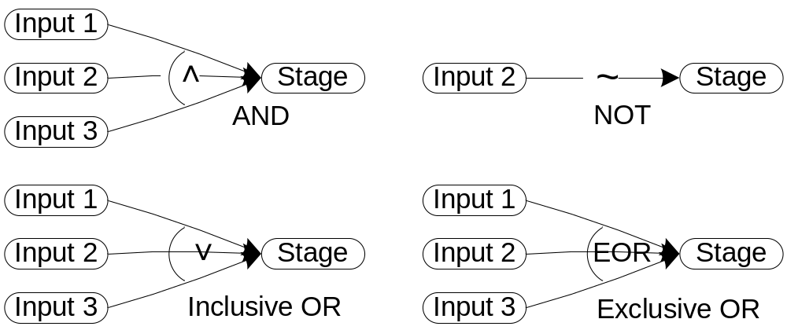
Cause and Effect Graphs (basic gates)

Slide 28
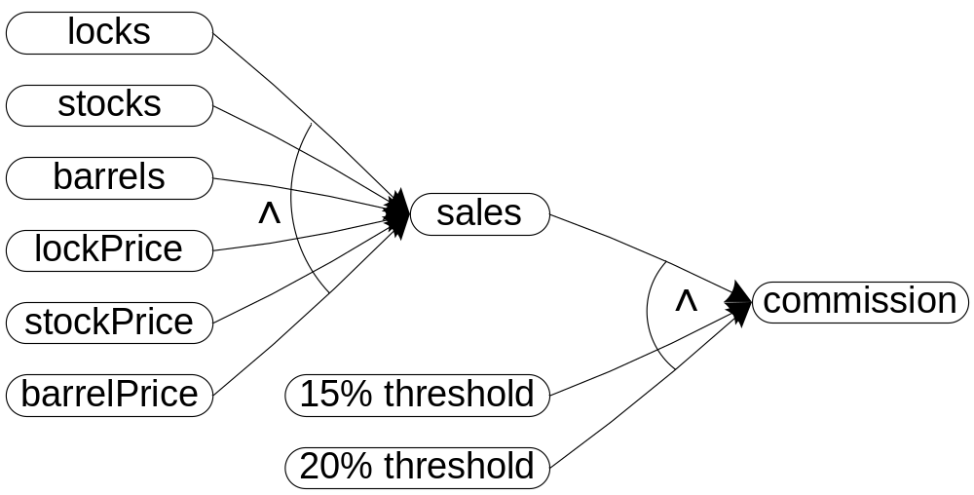
Cause and Effect Graph for the Commission Problem

